Slide 1

Module One Presentaion
Pura Riggins

Slide 2
Goals
: Translate findings into actionable insight

Slide 3
What to expect ?
Which genres had the most likes?
Which genres had the least amount of dislikes?
Listing the brands with the most profit earnings , what type of movies do each produce?
Listing of the sum of global gains that each genre had per year.

Slide 4
Personnel Aspects
Key Players: Regarding Brands and Audiences
Which brands are earning the greatest profit in returns ?
Which brands are gaining the most internationally?
Influencial Factors such as like and dislikes

Slide 5
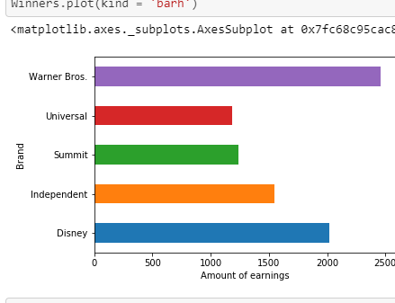
High Gainers
Warner Bros. Disney Independent also are the top 3 in global gains

Slide 6
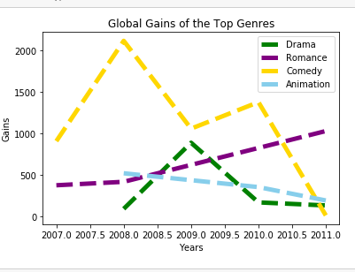
Brand Gains
Brand gains over the years 2007 to 2011
Comedy and Romance movies seem to be the most reliable

Slide 7
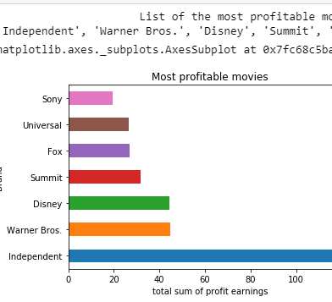
High Profit Brand
Independent holds a majority share of profits with Warner Bros. And Disney

Slide 8
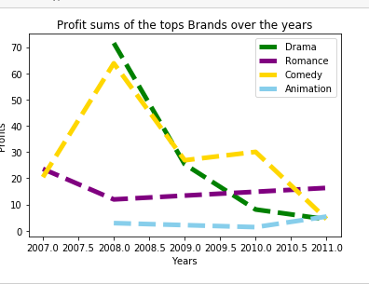
Brand Profits
Comedy movies usually increase after a slup while Romance films remain improve gradually

Slide 9
Rate of likes and dislikes
which type of movies hold a high rating of approval from?
Does likes come at the expense of negative ratings ?
which type of movies hold a high rating of approval from the audiences
which type of movies hold the least amount of criticism

Slide 10
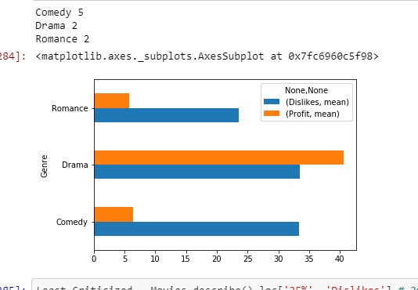
Profit/ Dislikes
Genres still gain a high profit despite a high rate of criticism

Slide 11
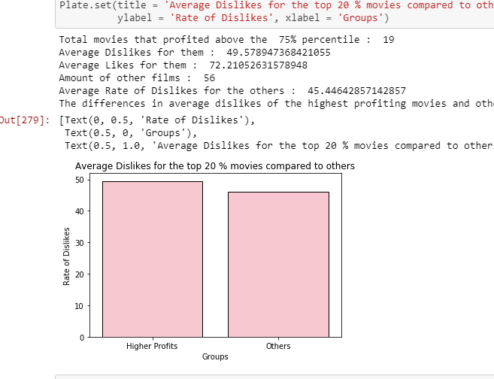
Averages Dislikes
Difference in dislikes is slightly marginal and not enough to make the argument that it has an effective on profits

Slide 12
Motives
I wanted to find out whether if a brand's rate of dislikes had an effect on the amount of profit that each earned. My conclusion was that it certainly did not and the difference among high profiting films and others average rating of dislikes were less than 5 points from each other and presented no correlation.

Slide 13
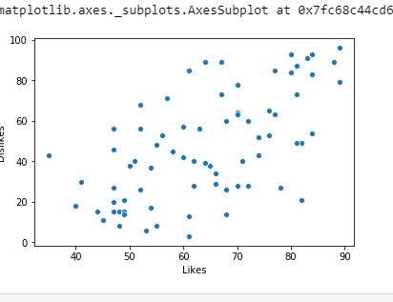
Likes vs Dislikes
High number of likes come at the expense of a large number of criticisims

Slide 14
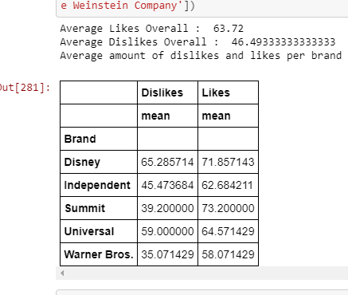
Likes / Dislikes Diff
The top brands display likes and dislikes near the overall means with only two falling out of the 10 point marks

Slide 15
Future Endeavors
Since we've accomplished the goals of finding out which specific brands and actors the next steps would be to conduct competitive analysis and target these brands in particular in each specific genre
Why? These brands have experience and hold a large amount of market share;

